Slide 1
8086
Hardware Specifications

Slide 2
8086 Memory Addressing
The 8086 memory address space can be viewed as a sequence of one million bytes in which any byte may contain an 8-bit data element and any two consecutive bytes may contain a 16-bit data element
The address space is physically connected to a 16-bit data bus by dividing the address space into two 8-bit banks of up to 512K bytes each

Slide 3
One bank is connected to the lower half of the 16-bit data bus (D0 – D7) and contains even address bytes. i.e., when A0 bit is low, the bank is selected
The other bank is connected to the upper half of the data bus (D8 - D15) and contains odd address bytes. i.e., when A0 is high and BHE (Bus High Enable) is low, the odd bank is selected
A specific byte within each bank is selected by address lines A1-A19

Slide 4
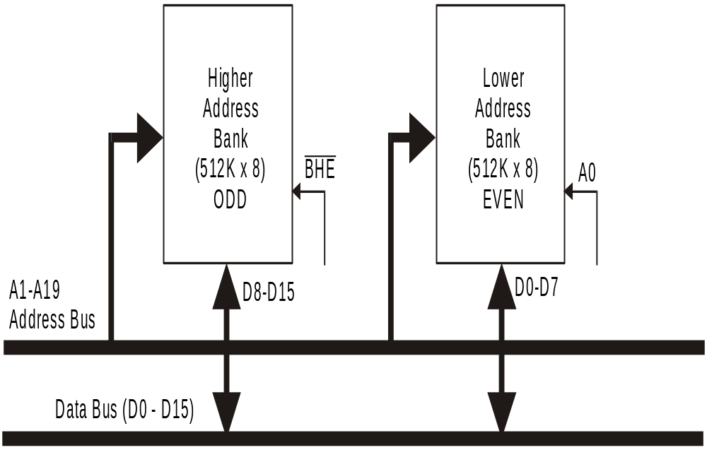

Slide 5
Data can be accessed from the memory in four different ways
8 - bit data from Lower (Even) address Bank
8 - bit data from Higher (Odd) address Bank
16 - bit data starting from Even Address
16 - bit data starting from Odd Address

Slide 6
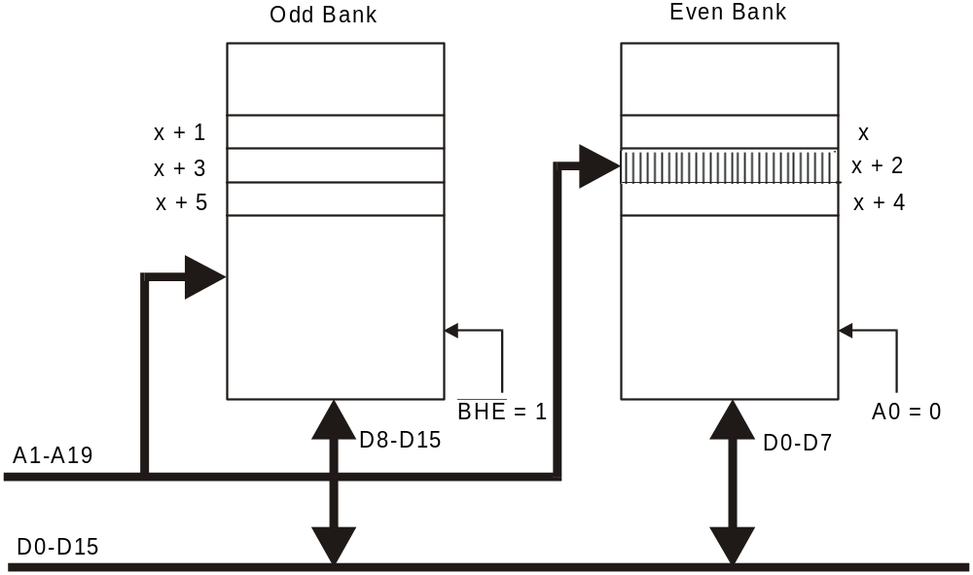
8-bit data from Even address Bank

Slide 7
To access memory bytes from Even address, information is transferred over the lower half of the data bus (D0 - D7)
The A0 is output LOW and BHE is output HIGH enabling only the even address bank

Slide 8
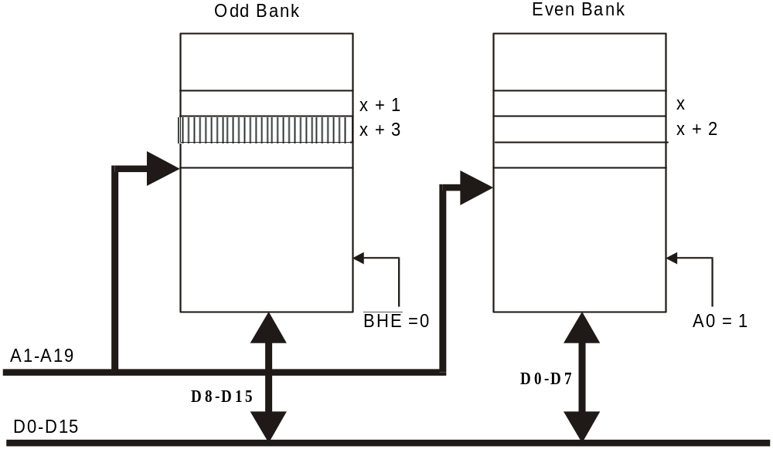
8-bit Data from Odd Address Bank

Slide 9
To access memory byte from an odd address information, is transferred over the higher half of the data bus (D8 - D15)
The BHE output low enables the upper memory bank
A0 is output high to disable the lower memory bank

Slide 10
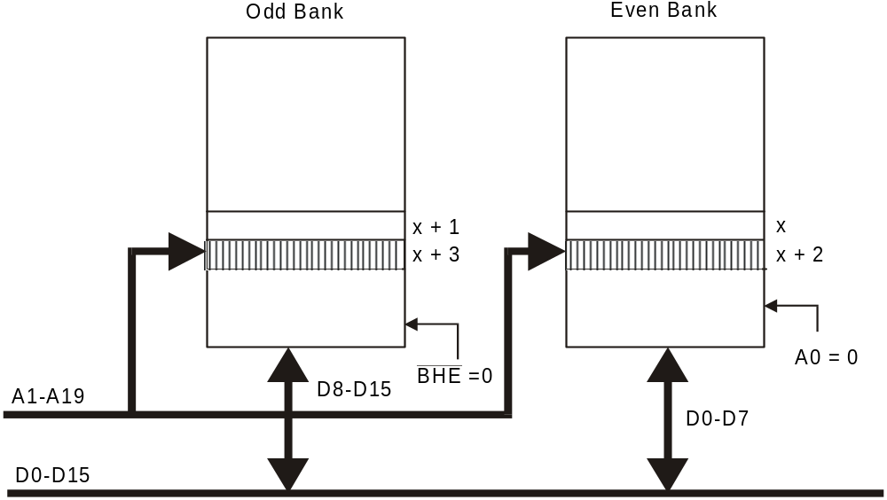
16-bit Data Access starting from Even - Address

Slide 11
16-bit data from an even address is accessed in a single bus cycle
Address lines A1 - A19 select the appropriate byte within each bank
A0 low and BHE low enables both banks simultaneously

Slide 12
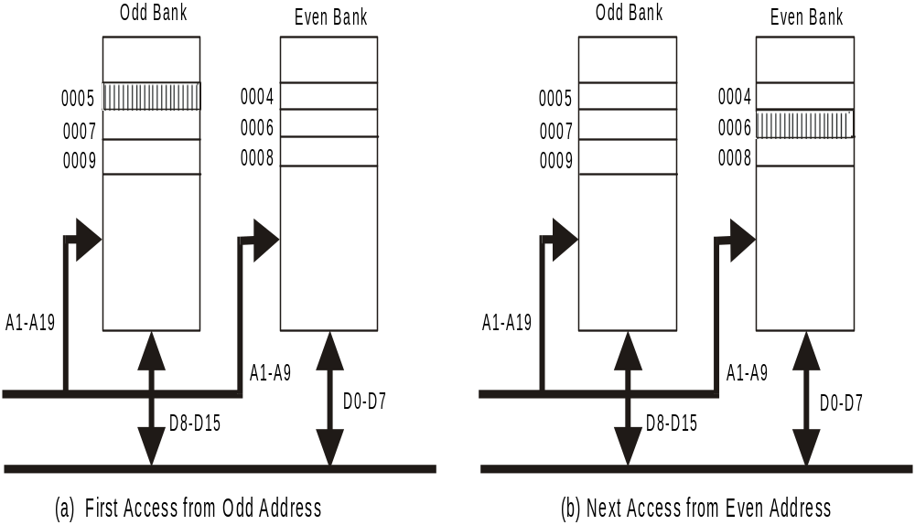
16-bit Data Access starting from Odd Address

Slide 13
A 16-bits word located at an odd address (two consecutive bytes with the least significant byte at an odd byte address) is accessed using two bus cycles
During the first bus cycle the lower byte (with the odd address 0005 as shown in fig. in previous slide) is accessed
During the second bus cycle, the upper byte (with the even address 0006H as in fig. in previous slide) is accessed

Slide 14
During the first bus cycle, A1 - A19 address bus specifies the address and A0 as 1 and BHE is low
Therefore the even memory bank is disabled and odd memory bank is enabled
During the second bus cycle, the address is incremented
Therefore A0 is zero and BHE is made high
The even memory bank is enabled and the odd memory bank is disabled

Slide 15
Operation | BHE | A₀ | Data Lines Used
Read/Write a byte at an even address | 1 | 0 | D7 – D0
Read/Write a byte at an odd address | 0 | 1 | D15 – D8
Read/Write a word at an even address | 0 | 0 | D15 – D0
Read/Write a word at an odd address | 0 1 | 1 0 | D15 – D8 in first operation byte from odd bank is transferred D7 – D0 in first operation byte from odd bank is transferred

Slide 16
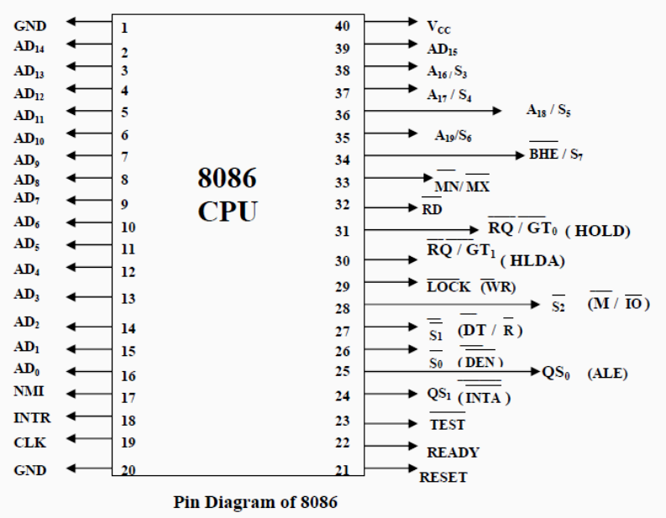

Slide 17
8086 has been designed to work in two operating modes
  Minimum mode
  Maximum mode
Minimum mode is used for small systems with a single processor
Maximum mode is used for medium size to large systems, which often include two or more processors

Slide 18
The 8086 signals can be categorized in three groups
  Signals having common functions in both minimum and maximum modes
  Signals having special functions for minimum mode
  Signals having special functions for maximum mode

Slide 19
Signals having common functions in both minimum and maximum modes

Slide 20
AD0 - AD15 (I/O): Address Data Bus
These lines constitute the time multiplexed memory/IO address during the first clock cycle (T1) and data during T2, T3 and T4 clock cycles
Address remains on the lines during T1 state, while the data is available on the data bus during T2, T3, and T4 clock cycles

Slide 21
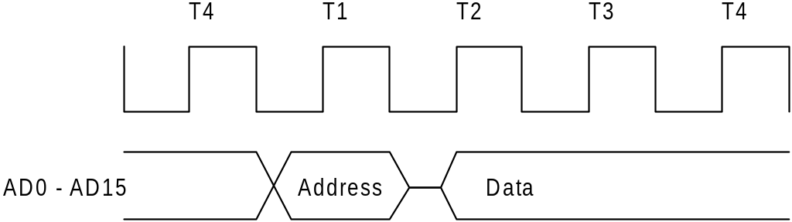
Timing of AD0 – AD15 lines to access data and
address

Slide 22
A19/S6, A18/S5, A17/S4, A16/S3 (O): Address/Status
During T1 state these lines are the four most significant address lines for memory operations
During I/O operations these lines are low
During memory and I/O operations, status information is available on these lines during T2, T3, and T4 states

Slide 23
S5: The status of the interrupt enable flag bit is updated at the beginning of each cycle. The status of the flag is indicated through this bus
S6: When Low, it indicates that 8086 is in control of the bus. During a "Hold acknowledge" clock period, the 8086 tri-states the S6 pin and thus allows another bus master to take control of the status bus

Slide 24
S3 & S4: Lines are decoded as follows…
S₄ | S₃ | Function
0 | 0 | Extra segment access
0 | 1 | Stack segment access
1 | 0 | Code segment access
1 | 1 | Data segment access

Slide 25
After the first clock cycle of an instruction execution, the A17/S4 and A16/S3 pins specify which segment register generates the segment portion of the 8086 address

Slide 26
BHE/S7 (O): Bus High Enable/Status
During T1 state the BHE should be used to enable data onto the most significant half of the data bus, pins D15 - D8
BHE is Low during T1 state of read, write and interrupt acknowledge cycles when a byte is to be transferred on the high portion of the bus

Slide 27
The S7 status information is available during T2, T3 and T4 states
This pin is Low during T1 state for the first interrupt acknowledge cycle

Slide 28
RD (O): READ
The Read strobe indicates that the processor is performing a memory or I/O read cycle
This signal is active low during T2 and T3 states of any read cycle

Slide 29
TEST (I):
TEST pin is examined by the "WAIT" instruction
If the TEST pin is Low, execution continues. Otherwise the processor waits in an "idle" state
This input is synchronized internally during each clock cycle on the leading edge of CLK

Slide 30
INTR (I): Interrupt Request
It is a level triggered input which is sampled during the last clock cycle of each instruction to determine if the processor should enter into an interrupt acknowledge operation
A subroutine is vectored to via an interrupt vector look up table located in system memory
This signal is active HIGH

Slide 31
NMI (I): Non-Maskable Interrupt
An edge triggered input, causes a type - 2 interrupt
A subroutine is vectored to via the interrupt vector look up table located in system memory
NMI is not maskable internally by software
A transition from a LOW to HIGH on this pin initiates the interrupt at the end of the current instruction

Slide 32
Reset (I) :
Reset causes the processor to immediately terminate its present activity
To be recognized, the signal must be active high for at least four clock cycles, except after power-on which requires a 50 Micro Sec. pulse
It causes the 8086 to initialize registers DS, SS, ES, IP and flags to all zeros.
It also initializes CS to FFFF H.

Slide 33
Upon removal of the RESET signal from the RESET pin, the 8086 will fetch its next instruction from the 20 bit physical address FFFF0H
The reset signal to 8086 can be generated by the 8284 (Clock generation chip)
To guarantee reset from power-up, the reset input must remain below 1.5 volts for 50 Micro sec after Vcc has reached the minimum supply voltage of 4.5V

Slide 34
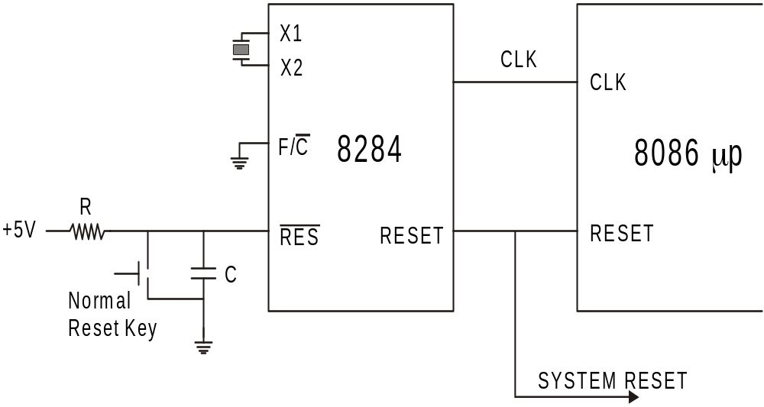
The RES input of the 8284 can be driven by a simple RC circuit

Slide 35
CPU component | Contents
Flags | Cleared
Instruction Pointer | 0000H
CS register | FFFFH
DS register | 0000H
SS register | 0000H
ES register | 0000H
Queue | Empty
When the processor detects the positive-going edge of a pulse on RESET, it terminates all activities until the signal goes low, at which time it initializes the system as shown in table

Slide 36
Ready (I):
Ready is the acknowledgement from the addressed memory or I/O device that it will complete the data transfer
The READY signal from memory or I/O is synchronized by the 8284 clock generator to form READY
This signal is active HIGH

Slide 37
CLK (I): Clock
Clock provides the basic timing for the processor and bus controller
Its an asymmetric square wave with 33% duty cycle
Minimum frequency of 2 MHz is required, since the design of 8086 processors incorporates dynamic cells

Slide 38
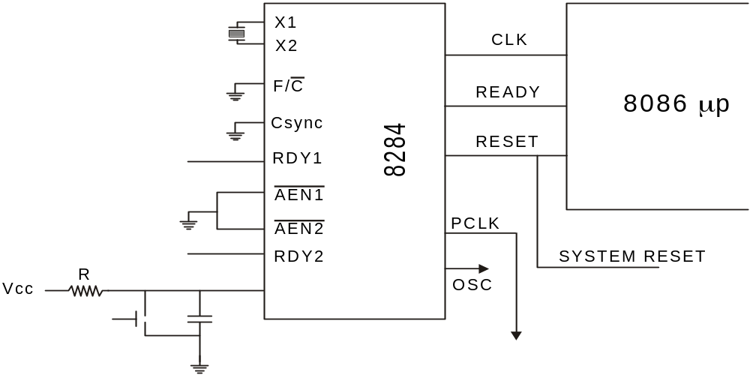
Since the 8086 does not have on-chip clock generation circuitry, and 8284 clock generator chip must be connected to the 8086 clock pin

Slide 39
The crystal connected to 8284 must have a frequency 3 times the 8086 internal frequency
The 8284 clock generation chip is used to generate READY, RESET and CLK

Slide 40
MN/MX (I): Maximum / Minimum
This pin indicates what mode the processor is to operate in
In minimum mode, the 8086 itself generates all bus control signals
In maximum mode the three status signals are to be decoded to generate all the bus control signals

Slide 41
Signals having special functions for Minimum Mode

Slide 42
The following 8 pins function descriptions are for the 8086 in minimum mode; MN/MX = 1

Slide 43
M/IO (O) : (Memory / IO)
This pin is used to distinguish a memory access or an I/O accesses
When this pin is Low, it accesses I/O and when high it access memory
Becomes valid in the T4 state preceding a bus cycle and remains valid until the final T4 of the cycle

Slide 44
WR (O): Write
Indicates that the processor is performing a write memory or write IO cycle, depending on the state of the M/IO signal
WR is active for T2, T3 and Tw of any write cycle
It is active LOW

Slide 45
INTA (O): Interrupt Acknowledge
It is used as a read strobe for interrupt acknowledge cycles
It is active LOW during T2, T3, and T4 of each interrupt acknowledge cycle

Slide 46
ALE (O): Address Latch Enable
This output signal indicates the availability of the valid address on the address/data lines, and is connected to latch enable input of latches
DT/R (O): DATA Transmit/Receive
This output is used to decide the direction of data flow through the transreceivers (bidirectional buffers)
When the processor sends out data, this signal is high and when the processor is receiving data, this signal is low

Slide 47
DEN: (Data Enable)
This signal indicates the availability of valid data over the address/data lines. It is used to enable the transreceivers ( bidirectional buffers ) to separate the data from the multiplexed address/data signal

Slide 48
HOLD & HLDA (I/O): Hold and Hold Acknowledge
When the HOLD line goes high, it indicates to the processor that another master is requesting the bus access
The processor, after receiving the HOLD request, issues the hold acknowledge signal on HLDA pin, in the middle of the next clock cycle after completing the current bus cycle
When the processor detects the HOLD line low, it lowers the HLDA signal

Slide 49
HOLD is an asynchronous input, and is should be externally synchronized
If the DMA request is made while the CPU is performing a memory or I/O cycle, it will release the local bus during T₄ provided:
1.The request occurs on or before T₂ state of the current cycle.
2.The current cycle is not operating over the lower byte of a word.
3.The current cycle is not the first acknowledge of an interrupt acknowledge sequence

Slide 50
Signals having special functions for maximum mode

Slide 51
The following pins function descriptions are for the 8086/8088 systems in maximum mode (i.e.. MN/MX=0)

Slide 52
S2, S1, S0 (O): Status Pins
These three status signals indicate the type of transfer to be taken place during the current bus cycle
These are used by the 8288 bus controller to generate all memory and I/O operation access control signals
Any change by S2, S1, S0 during T4 is used to indicate the beginning of a bus cycle

Slide 53
S₂ | S₁ | S₀ | Characteristics
0 | 0 | 0 | Interrupt acknowledge
0 | 0 | 1 | Read I/O port
0 | 1 | 0 | Write I/O port
0 | 1 | 1 | Halt
1 | 0 | 0 | Instruction Fetch
1 | 0 | 1 | Read memory
1 | 1 | 0 | Write memory
1 | 1 | 1 | Inactive passive state

Slide 54
QS0, QS1 (O): Queue – Status
These lines give information about the status of the code-prefetch queue
These are active during the CLK cycle after while the queue operation is performed
This modification in a simple fetch and execute architecture of a conventional microprocessor offers an added advantage of pipelined processing of the instructions

Slide 55
The 8086 architecture has 6-byte instruction prefetch queue
Thus even the largest (6-bytes) instruction can be prefetched from the memory and stored in the prefetch
This results in a faster execution of the instructions
At the starting the CS:IP is loaded with the required address from which the execution is to be started

Slide 56
Initially, the queue will be empty an the microprocessor starts a fetch operation to bring one byte (the first byte) of instruction code, if the CS:IP address is odd or two bytes at a time, if the CS:IP address is even
The first byte is a complete opcode in case of some instruction (one byte opcode instruction) and is a part of opcode, in case of some instructions ( two byte opcode instructions), the remaining part of code lie in second byte

Slide 57
The second byte is then decoded in continuation with the first byte to decide the instruction length and the number of subsequent bytes to be treated as instruction data
The queue is updated after every byte is read from the queue but the fetch cycle is initiated by BIU only if at least two bytes of the queue are empty and the EU may be concurrently executing the fetched instructions

Slide 58
QS₁ | QS₀ | Characteristics
0 | 0 | No operation
0 | 1 | First byte of opcode from queue
1 | 0 | Queue is empty
1 | 1 | Subsequent byte from queue
The next byte after the instruction is completed is again the first opcode byte of the next instruction
A similar procedure is repeated till the complete execution of the program

Slide 59
LOCK(O):
This output pin indicates that other system bus master will be prevented from gaining the system bus, while the LOCK signal is low
The LOCK signal is activated by the ‘LOCK’ prefix instruction and remains active until the completion of the next instruction
When the CPU is executing a critical instruction which requires the system bus, the LOCK prefix instruction ensures that other processors connected in the system will not gain the control of the bus

Slide 60
RQ/GT0, RQ/GT1 (I/O): Request/Grant
These pins are used by other processors in a multi processor organization
Local bus masters of other processors force the processor to release the local bus at the end of the processors current bus cycle

Slide 61
General Bus Operation…

Slide 62
The 8086 has a common address and data bus
The address and data lines are multiplexed
That is address and data appear on this bus at different time intervals
This multiplexed address and data bus has to be demultiplexed externally with the use of latches and the ALE signal provided by 8086

Slide 63
Each processor bus cycle consists of at least four clock cycles
These are referred to as T₁, T₂, T₃ and T₄
The timing diagram for the general bus operation is given in next slide

Slide 64
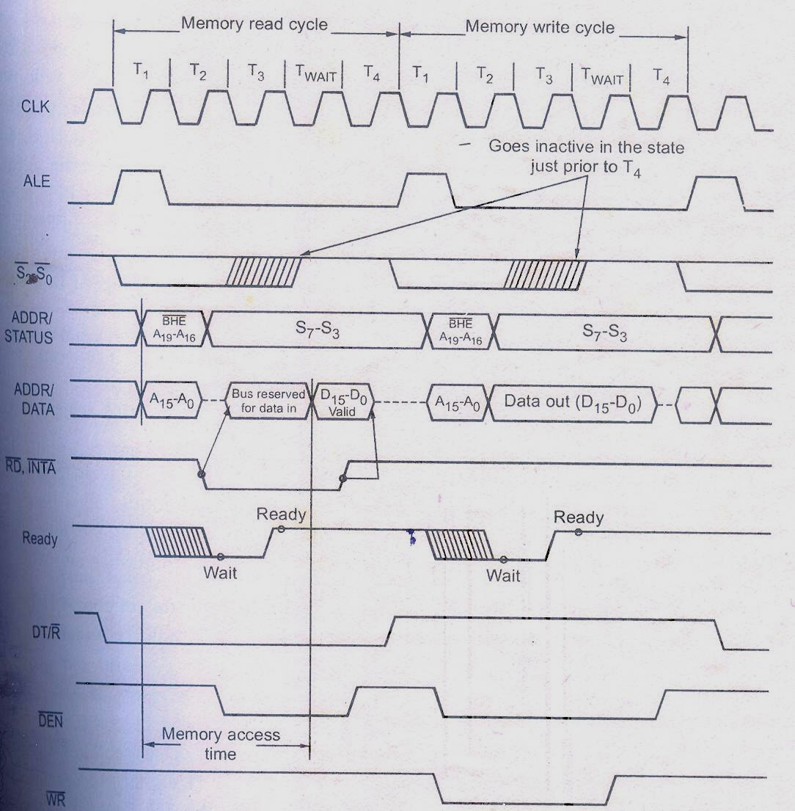
Ready signal is sampled during T₃
During T₁, processor sends address on
the address bus and activates ALE signal
The time interval T₂ is used primarily for changing the direction of
bus during read operations
The data transfer occurs on the bus
during T₃ and T₄

Slide 65
The slower peripheral devices use Ready signal to indicate that the device is not ready to send the desired data within specified time
In the event that a “NOT READY” indication is given by the slower peripheral device, WAIT states (Tw) are inserted between T2 and T3 to give enough time access time for the slower peripheral device
Each WAIT state is of the same duration as a clock cycle

Slide 66
The status bits S₀, S₁ and S₂ are used in maximum mode
by the bus controller to identify the type of bus transaction
If the Ready input is made high during WAIT state,
then after WAIT state the 8086 will go on with the regular
T₄ of the machine cycle
The 8086 will continue inserting WAIT states until the
Ready input is made high again
However, if the 8086 Ready input is still low at the end of
A WAIT state, then the 8086 will insert another WAIT state

Slide 67
S₂ | S₁ | S₀ | Characteristics
0 | 0 | 0 | Interrupt acknowledge
0 | 0 | 1 | Read I/O port
0 | 1 | 0 | Write I/O port
0 | 1 | 1 | Halt
1 | 0 | 0 | Instruction Fetch
1 | 0 | 1 | Read memory
1 | 1 | 0 | Write memory
1 | 1 | 1 | Inactive passive state

Slide 68
Status bits S₃ through S₇ are multiplexed with higher order address
bits and the BHE signal; These bits are also demultiplexed using latch
and the ALE signal During T1

Slide 69
S₄ | S₃ | Function
0 | 0 | Extra segment access
0 | 1 | Stack segment access
1 | 0 | Code segment access
1 | 1 | Data segment access
The S₃ and S₄ indicate which segment register was used for this bus cycle in forming the address
Out of the remaining status bits, S₅ is the reflection of the interrupt
enable bit of the flag register, S₆ is always 0 and S₇ is a spare
status bit

Slide 70
If a system is large enough to need data bus buffers,
then the 8086 DT/R signal connected to these buffers will set
them for input during a read operation or set them for
output during a write operation
The 8086 DEN signal will enable the buffers
at the appropriate times in the machine cycle

Slide 71
8086 Minimum Mode Operation…

Slide 72
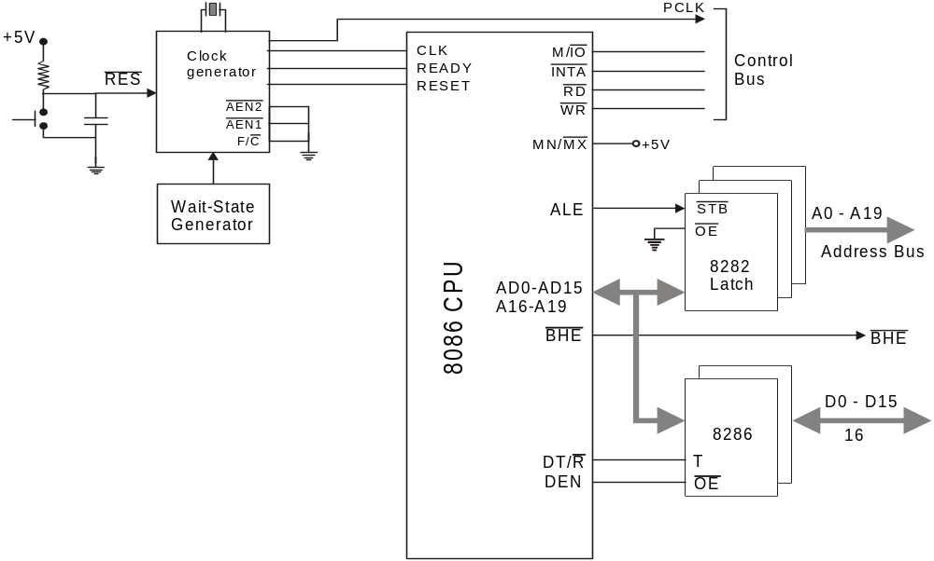
Minimum Mode Configuration…
These signals are de-multiplexed by external latches and
ALE signal generated by the processor
BHE
BHE
This is accomplished by using three ICs (Intel 8282), two of them
are required for a 16-bit address and three are needed if a full
20-bit address is used.
AD0 – AD15, A16/S3 – A19/S6 and BHE/S7 signals are multiplexed

Slide 73
Minimum Mode Configuration…
When this signal is low, receivers are enabled, so that 8086
can read data from Memory or input device
The Intel 8286 device is used to implement the transceiver block
BHE
DT/R signal is connected to the T input,
which controls the direction of the flow
To write data into memory or output device, the 8086’s DT/R signal goes high
BHE

Slide 74
Minimum Mode Configuration…
At the time of data transfer, to enable output of transceiver its
OE should be low
BHE
BHE
This is accomplished by connecting DEN signal of 8086 to the OE pin of 8286,
since DEN signal goes low when CPU is ready to send or receive data

Slide 75
Minimum Mode Configuration…
The 8284 clock generator does the following functions
1. Clock generation
BHE
2. RESET synchronization
BHE
3. READY synchronization
4. Peripheral clock generation

Slide 76
Bus Timings for Minimum Mode…

Slide 77
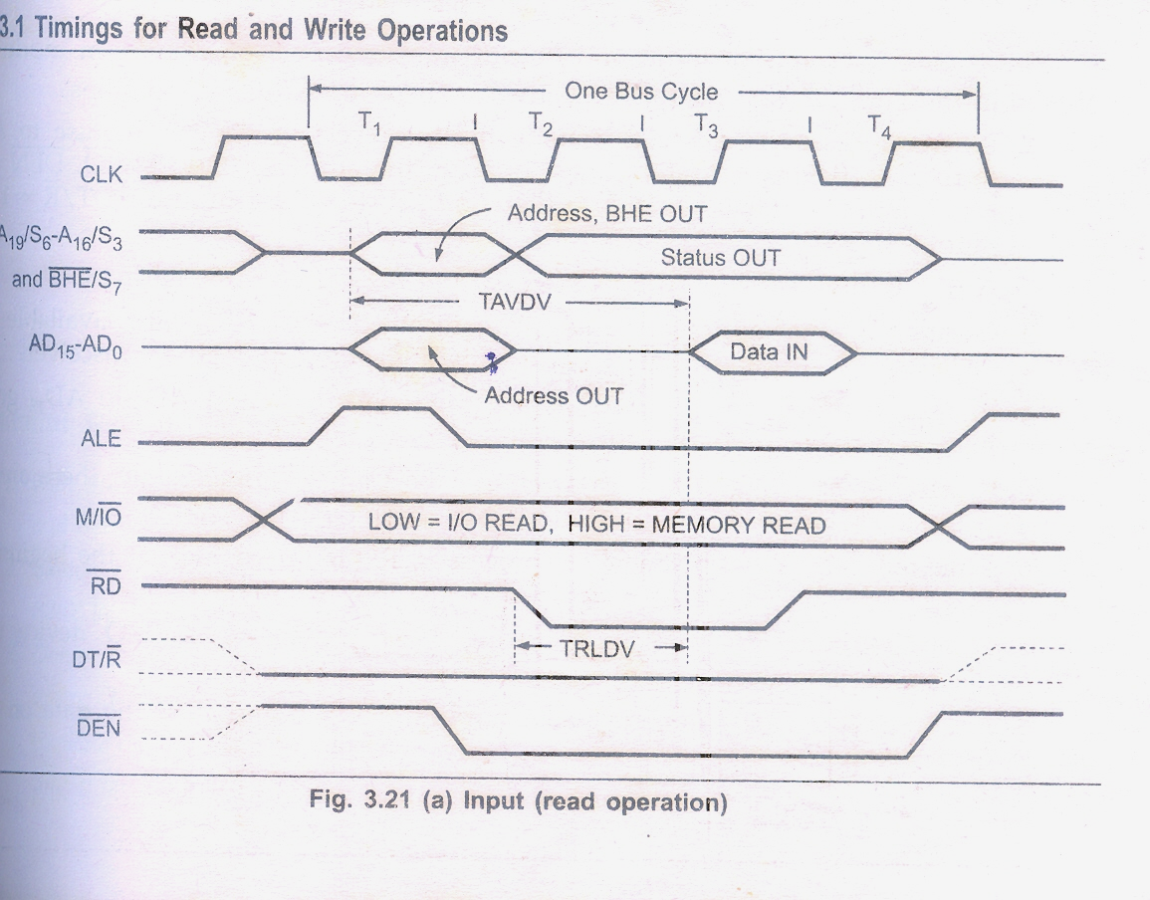
Bus Timing for Read Operation…
Before the falling edge of ALE, the address, BHE, M/IO, DEN and DT/R
must be stable. DEN = high and DT/R=0 for input
When processor is ready to initiate the bus cycle it applies a pulse
to ALE during T₁
At the trailing edge of ALE, IC 8282 latches the address

Slide 78
Bus Timing for Read Operation…
RD is activated during T2
Upon detecting this transition during T4, the memory or I/O device
will disable its data signals
During T2 the address signals are disabled and S3 – S7 are available on
AD16/S3 – AD19/S6 and BHE/S7. Also DEN is lowered to enable transceiver
If memory or I/O interface can perform the transfer immediately, there are
no wait states and data is output on the bus during T₃
After the data is accepted by the processor, RD is raised high at the
beginning of T4

Slide 79
Bus Timing for Read Operation…
DEN is raised during T4 to disable the transceiver

Slide 80
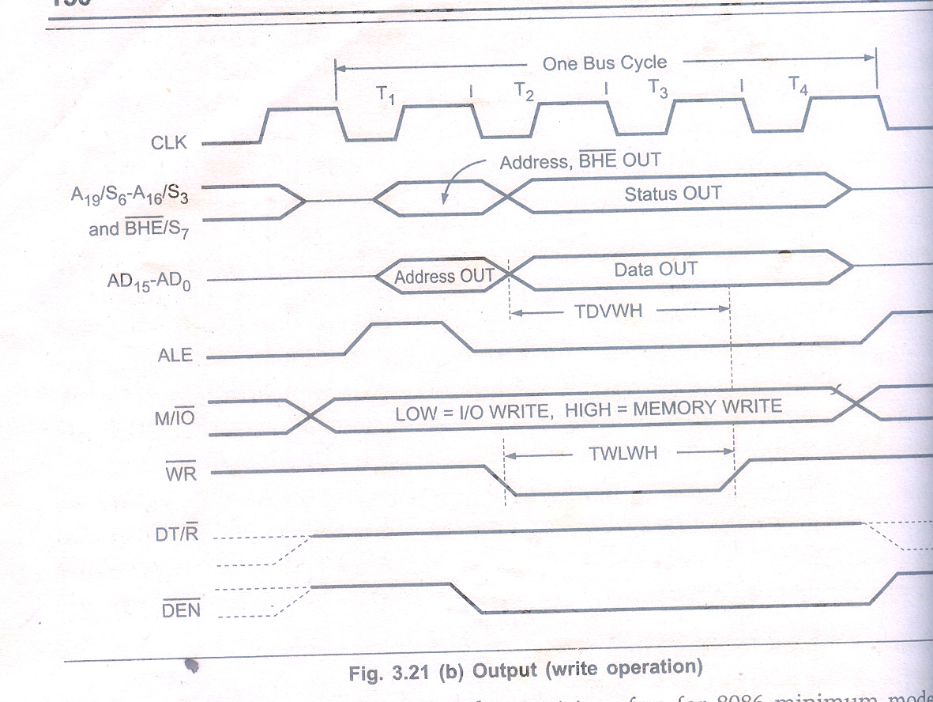
Bus Timing for Write Operation…
Before the falling edge of ALE, the address, BHE, M/IO, DEN and DT/R
must be stable. DEN = high and DT/R=1 for output
When processor is ready to initiate the bus cycle it applies a pulse
to ALE during T₁
At the trailing edge of ALE, IC 8282 latches the address

Slide 81
Bus Timing for Write Operation…
Processor applies WR = 0 and then the data on the data bus during T2
During T2 S3 – S7 are available on AD16/S3 – AD19/S6
and BHE/S7. Also DEN is lowered to enable transceiver
If memory or I/O interface can perform the transfer immediately, there are
no wait states; else wait states Tw are inserted between T₃ and T₄

Slide 82
Bus Timing for Write Operation…
DEN is raised during T4 to disable the transceiver
In T4, WR is raised high and data signals are disabled

Slide 83
8086 Maximum Mode Operation…

Slide 84
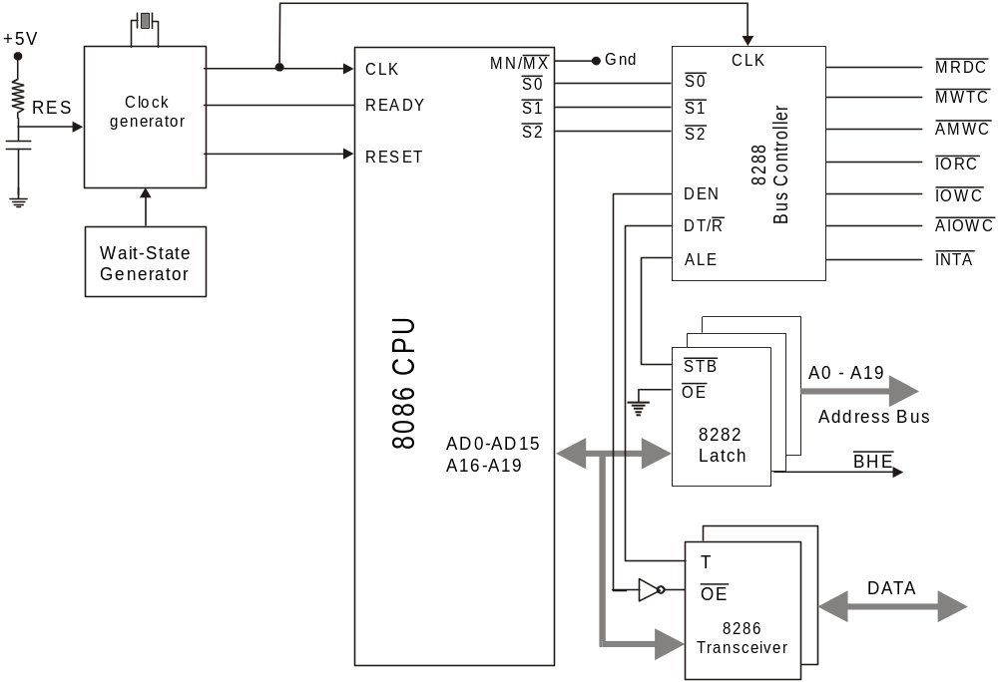
MRDC (Memory Read Command): Instructs the memory to put the contents
of the addressed location on the data bus
MWTC (Memory Write Command): Instructs the memory to accept the data
on the data bus and load the data into addressed memory location
Additional circuitry as compared to minimum mode…
It converts the status signals (S2 – S0) into the I/O and memory transfer
signals. It also generates the control signals required to direct the
data flow and for controlling 8282 latches and 8286 transceivers

Slide 85
IORC (I/O Read Command): Instructs an I/O device to put the data
contained in the addressed port on the data bus
IOWC (I/O Write Command): Instructs an I/O device to accept the data
on the data bus and load the data into the addressed port
AIOWC/AMWC (Advance I/O Write Command/Advance Memory Write Command:
These signals are similar to IOWC and MWTC except that they are activated
one clock pulse earlier. This gives slow interfaces an extra clock cycle to prepare
to input the data.

Slide 86
Bus Timings for Maximum Mode…

Slide 87
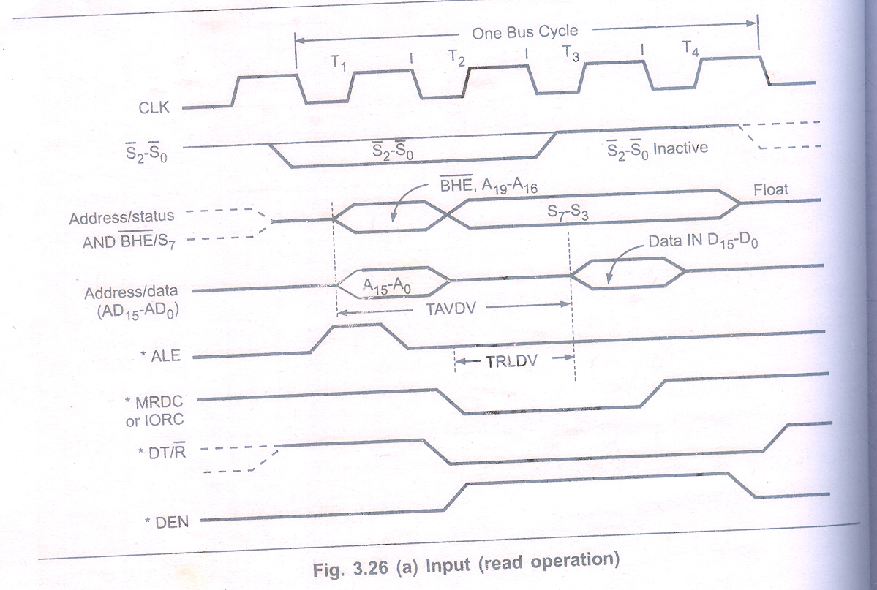
Bus Timing for Read Operation…

Slide 88
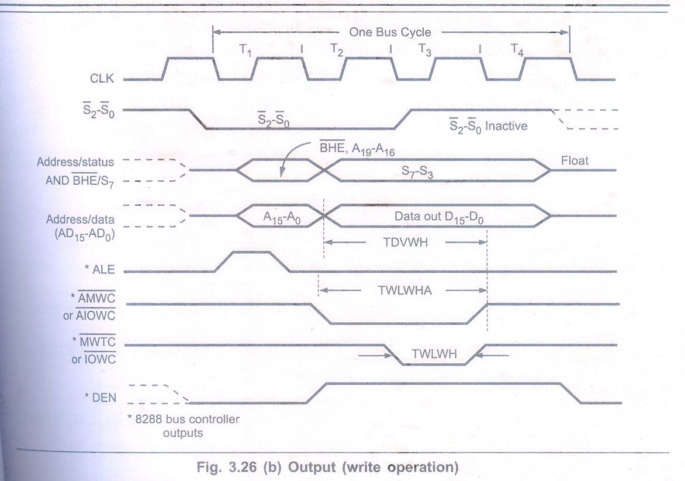
Bus Timing for Write Operation…

Slide 89
S₀, S₁ S₂ are set a the beginning of bus cycle. On detecting the change on passive state S₀=S₁=S₂=1, the 8288 bus controller will output a pulse on its ALE and apply a required signal to its DT/R pin during T₁
In T₂, 8288 will set DEN=1 thus enabling transceiver. For an input, 8288 it will activates MRDC or IORC. These signals are activated until T₄. For an output, the AMWC or AIOWC is activated from T₂ to T₄ and MWTC or IOWC is activated from T₃ to T₄

Slide 90
The status bits S₀ to S₂ remain active until T₃, and become passive during T₃ and T₄
If READY input is not activated before T₃, wait state will be inserted between T₃ and T₄

Slide 91
Thank You…

